Slide 1
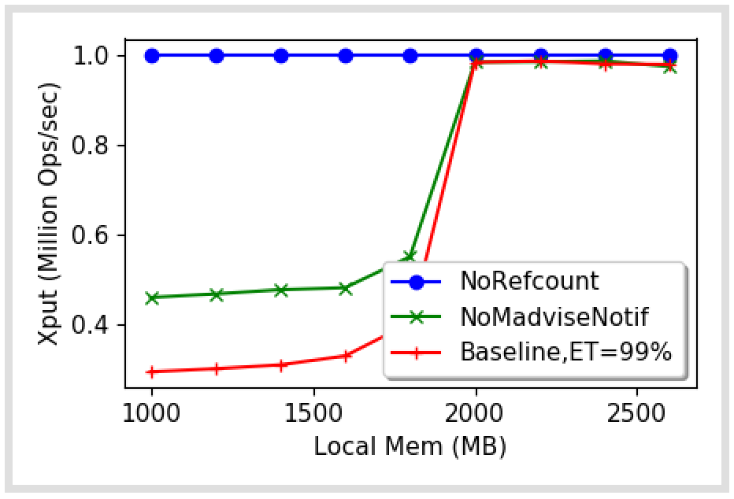
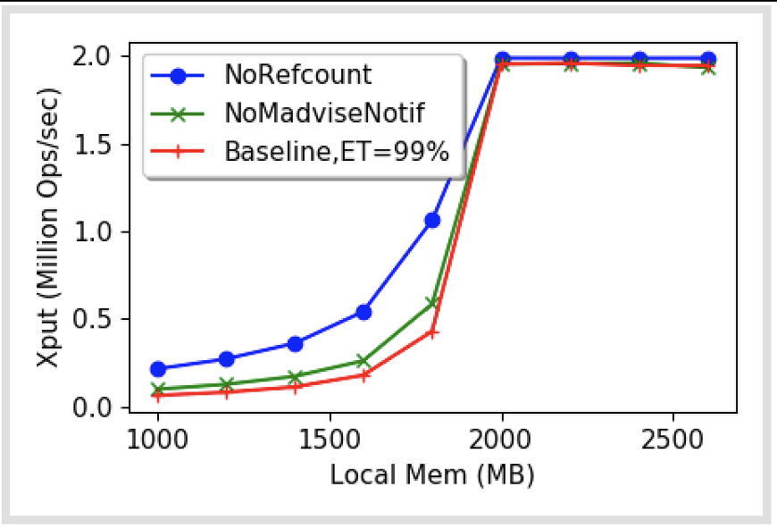
Update
Fixed Memcached dirtying!

Slide 2
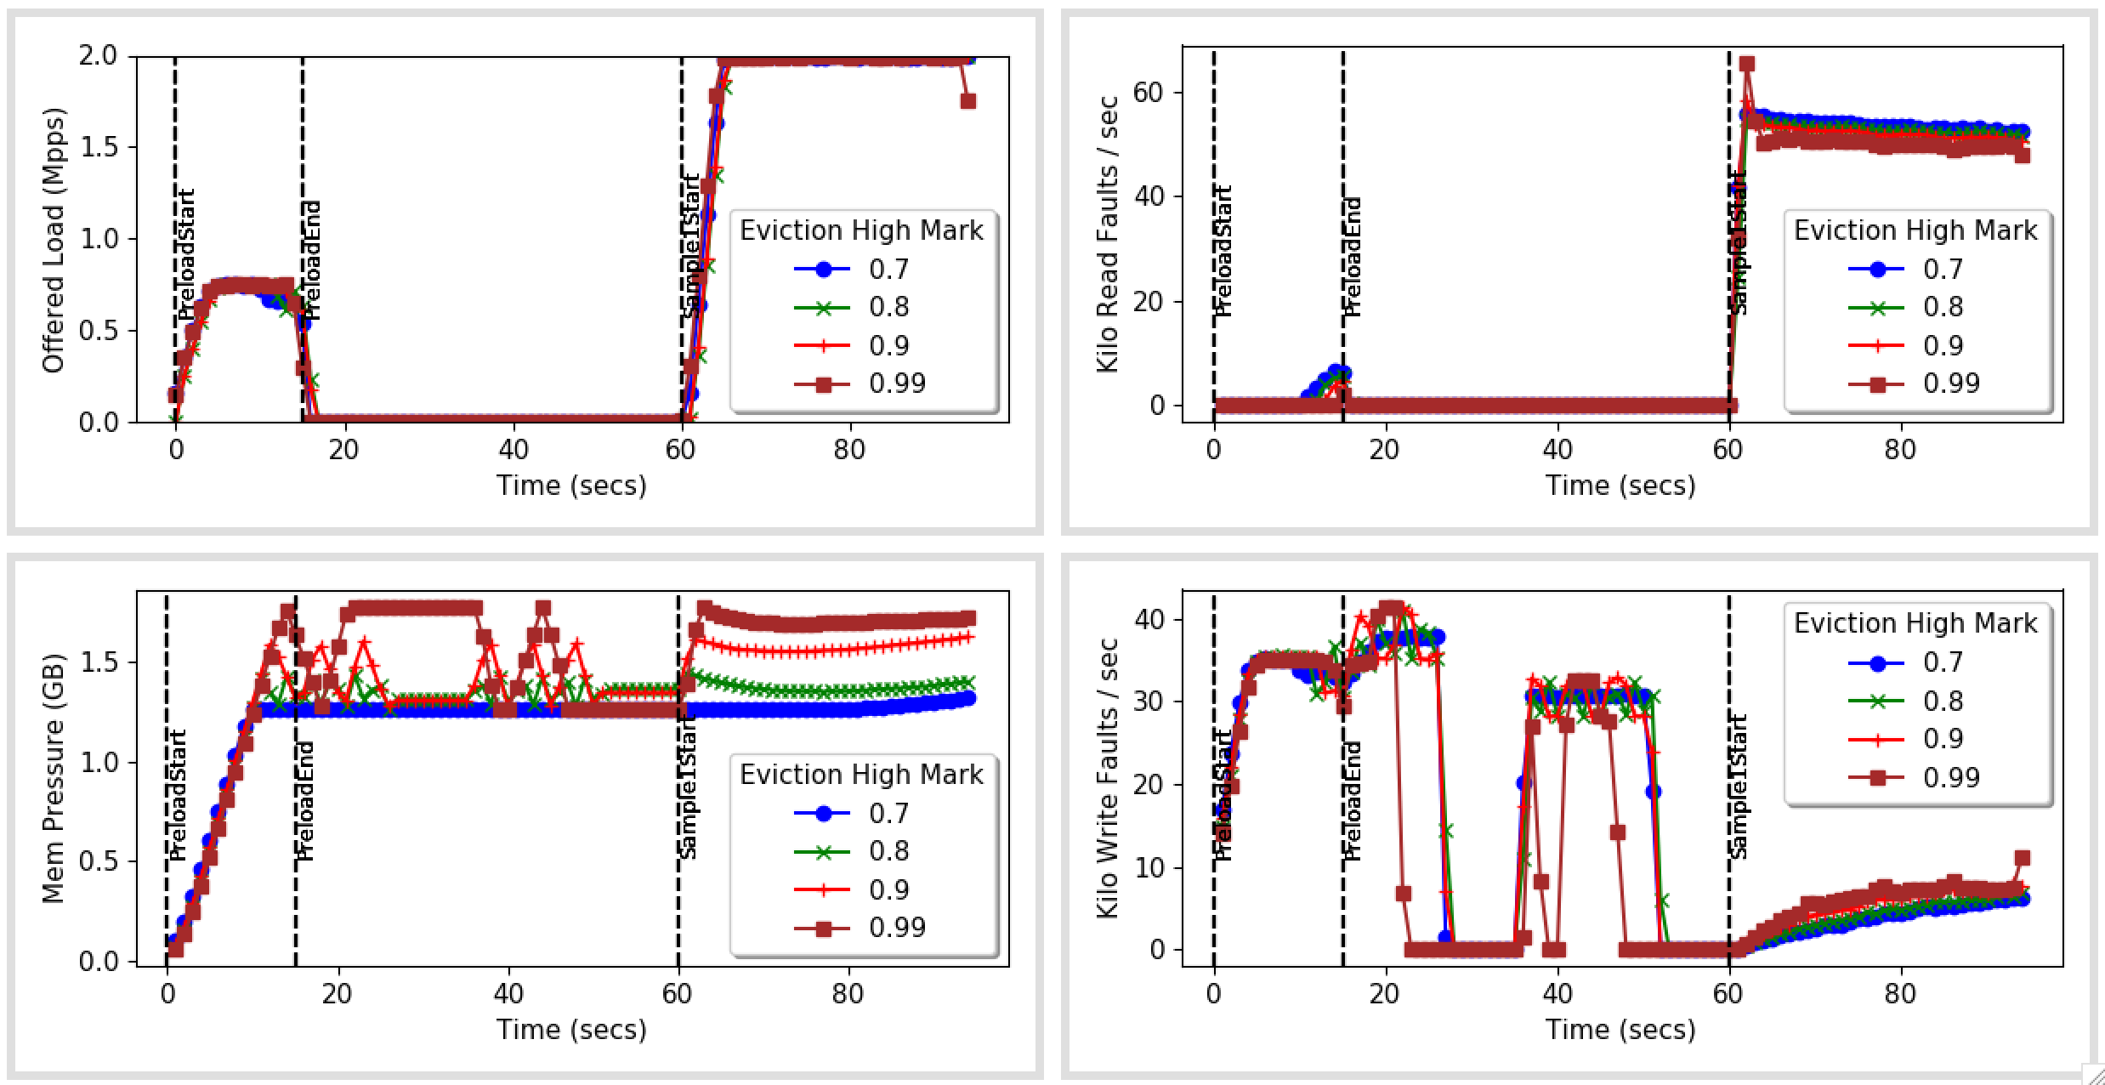
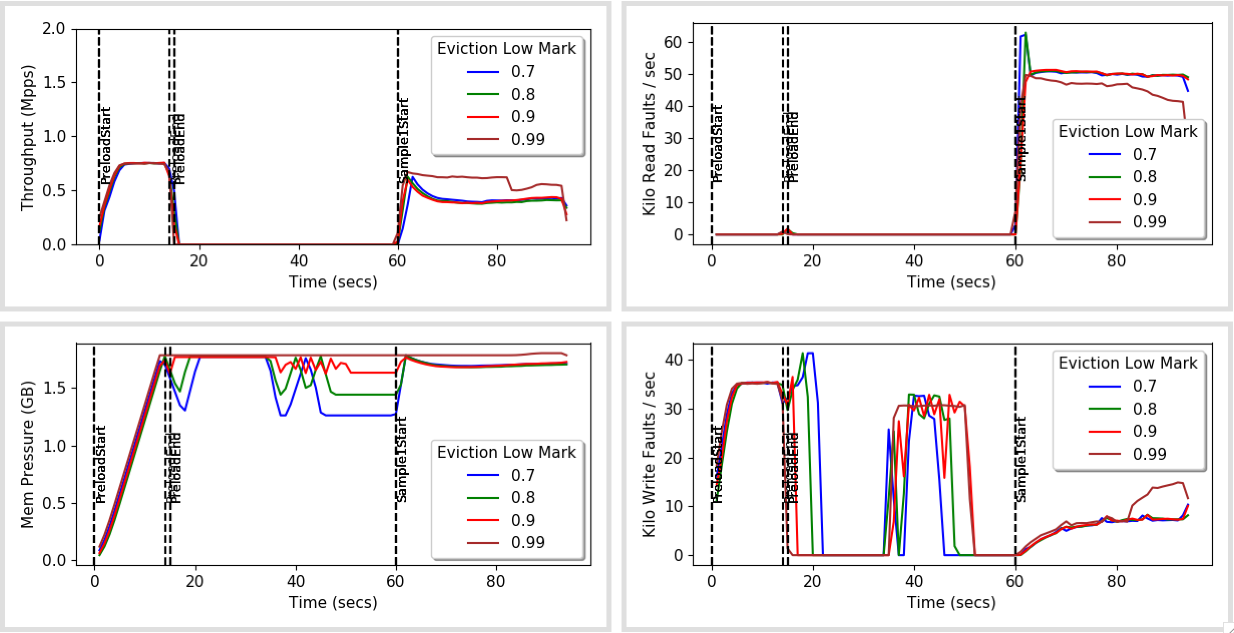
Varying Low, High = 99%
Notes:
Experiment with low = high and low ~= high

Slide 3
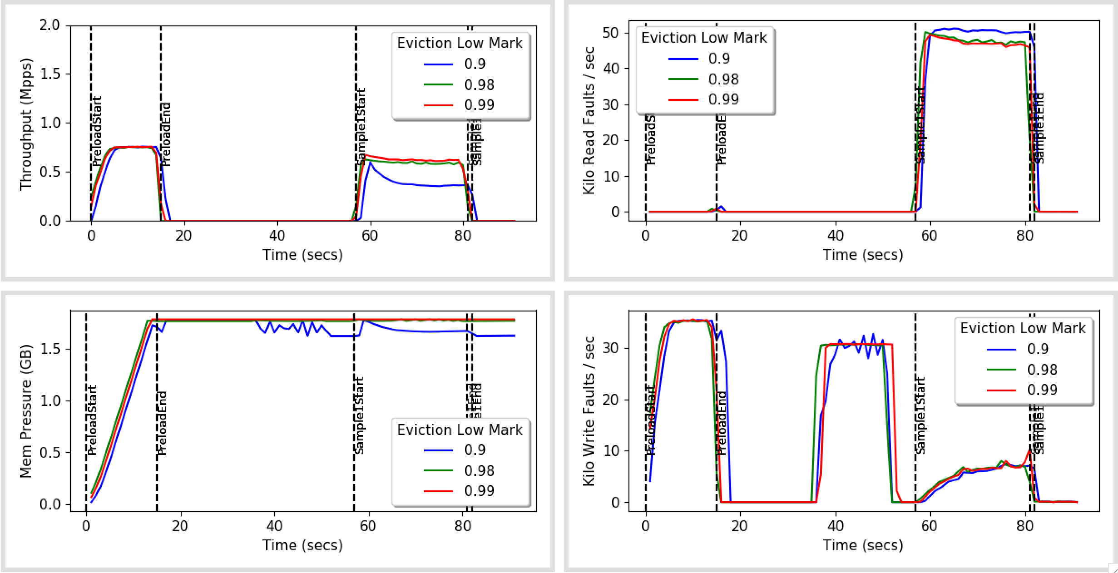
More values b/w 0.9 and 0.99

Slide 4
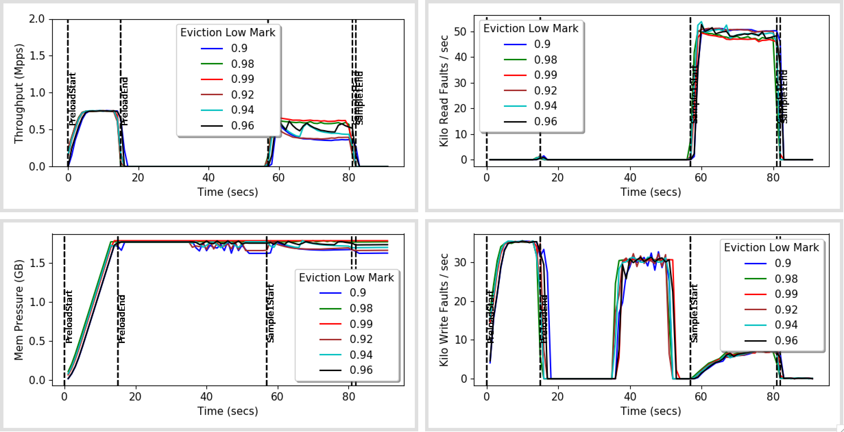
More values b/w 0.9 and 0.99

Slide 5
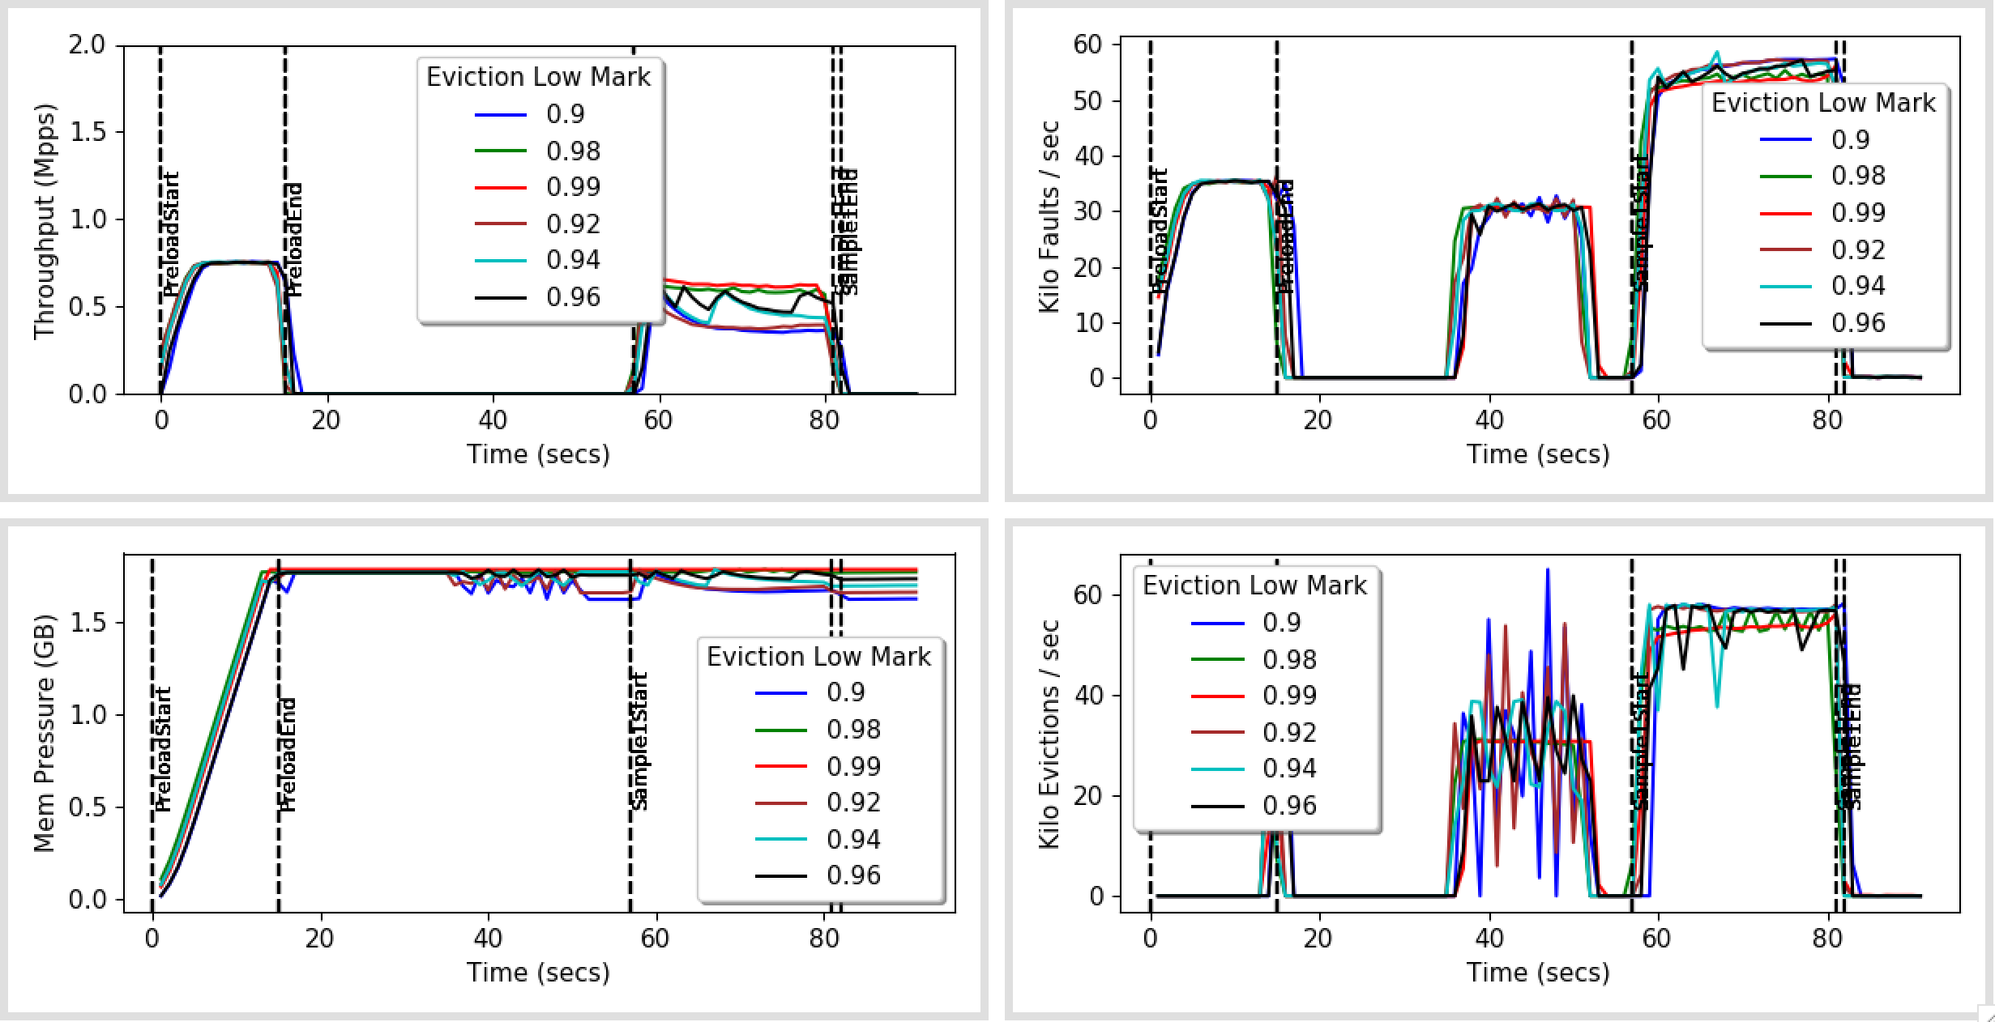
With Eviction Rate

Slide 6
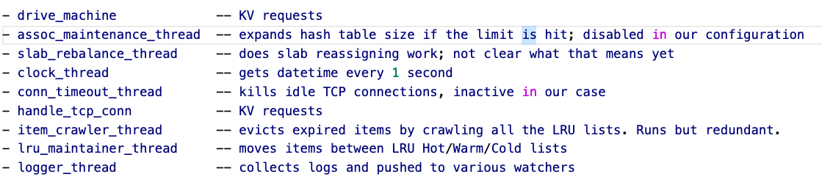
Memcached Worker Threads

Slide 7
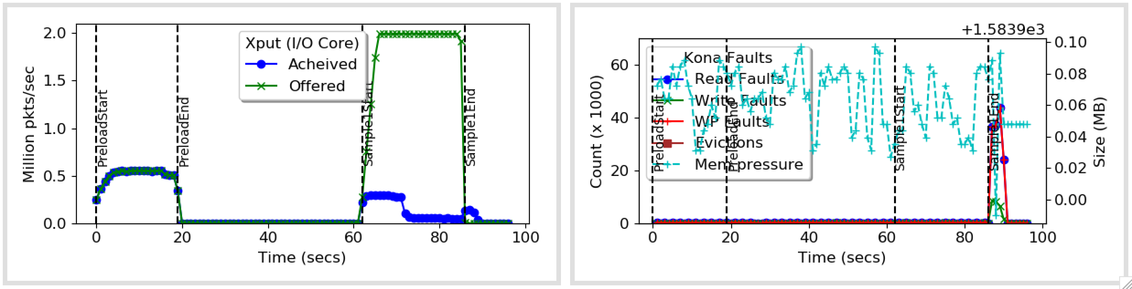
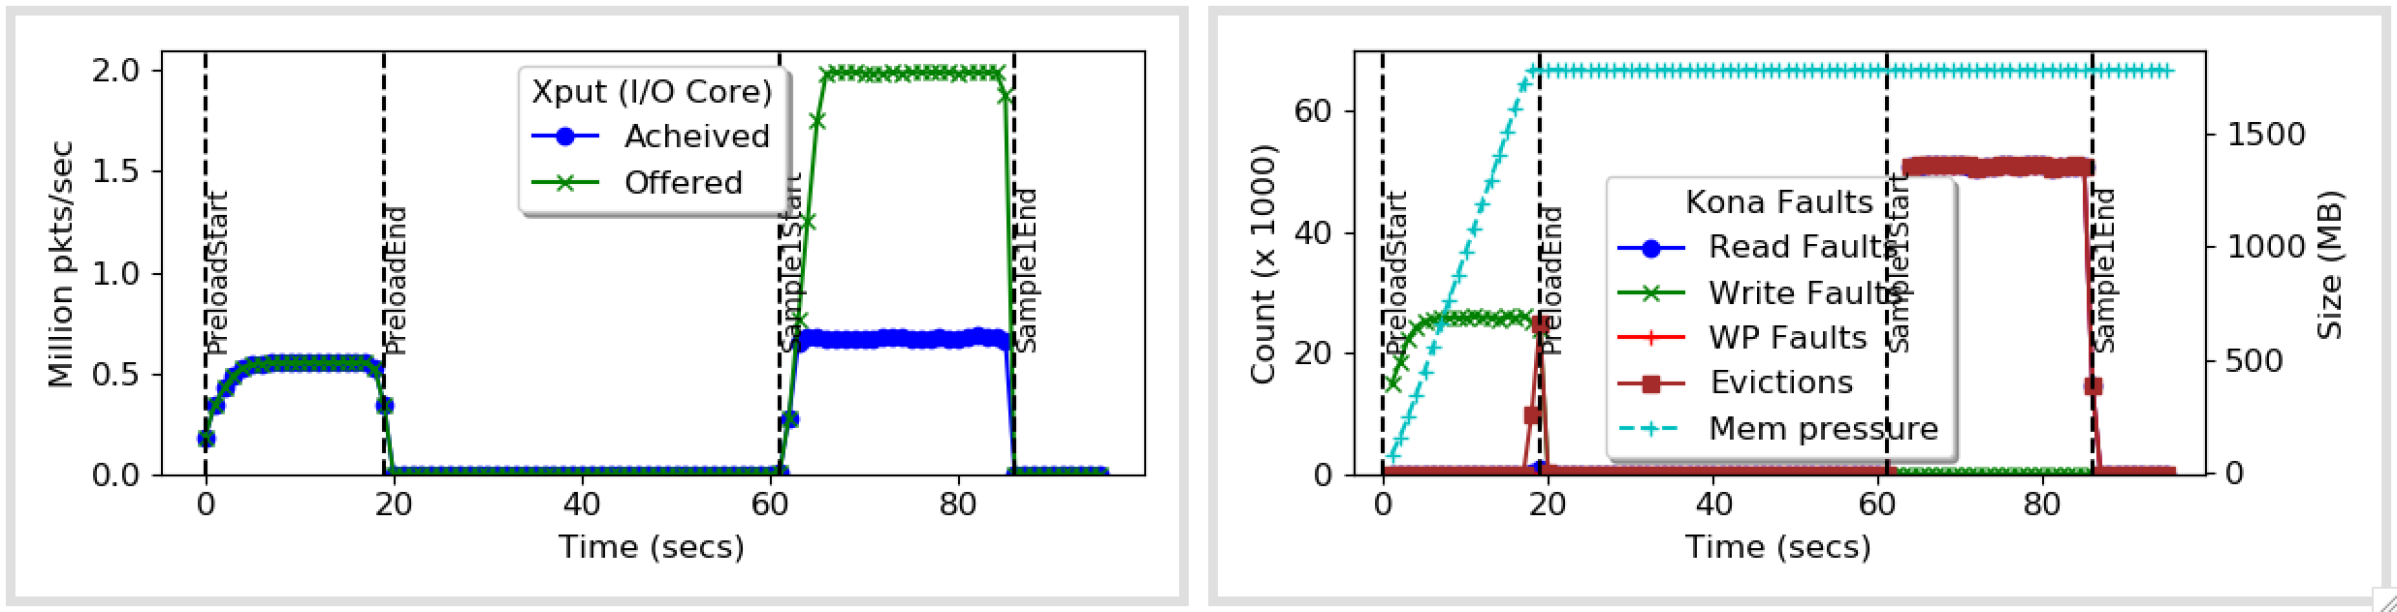
Fixing LRU Maintenance
Before
After

Slide 8
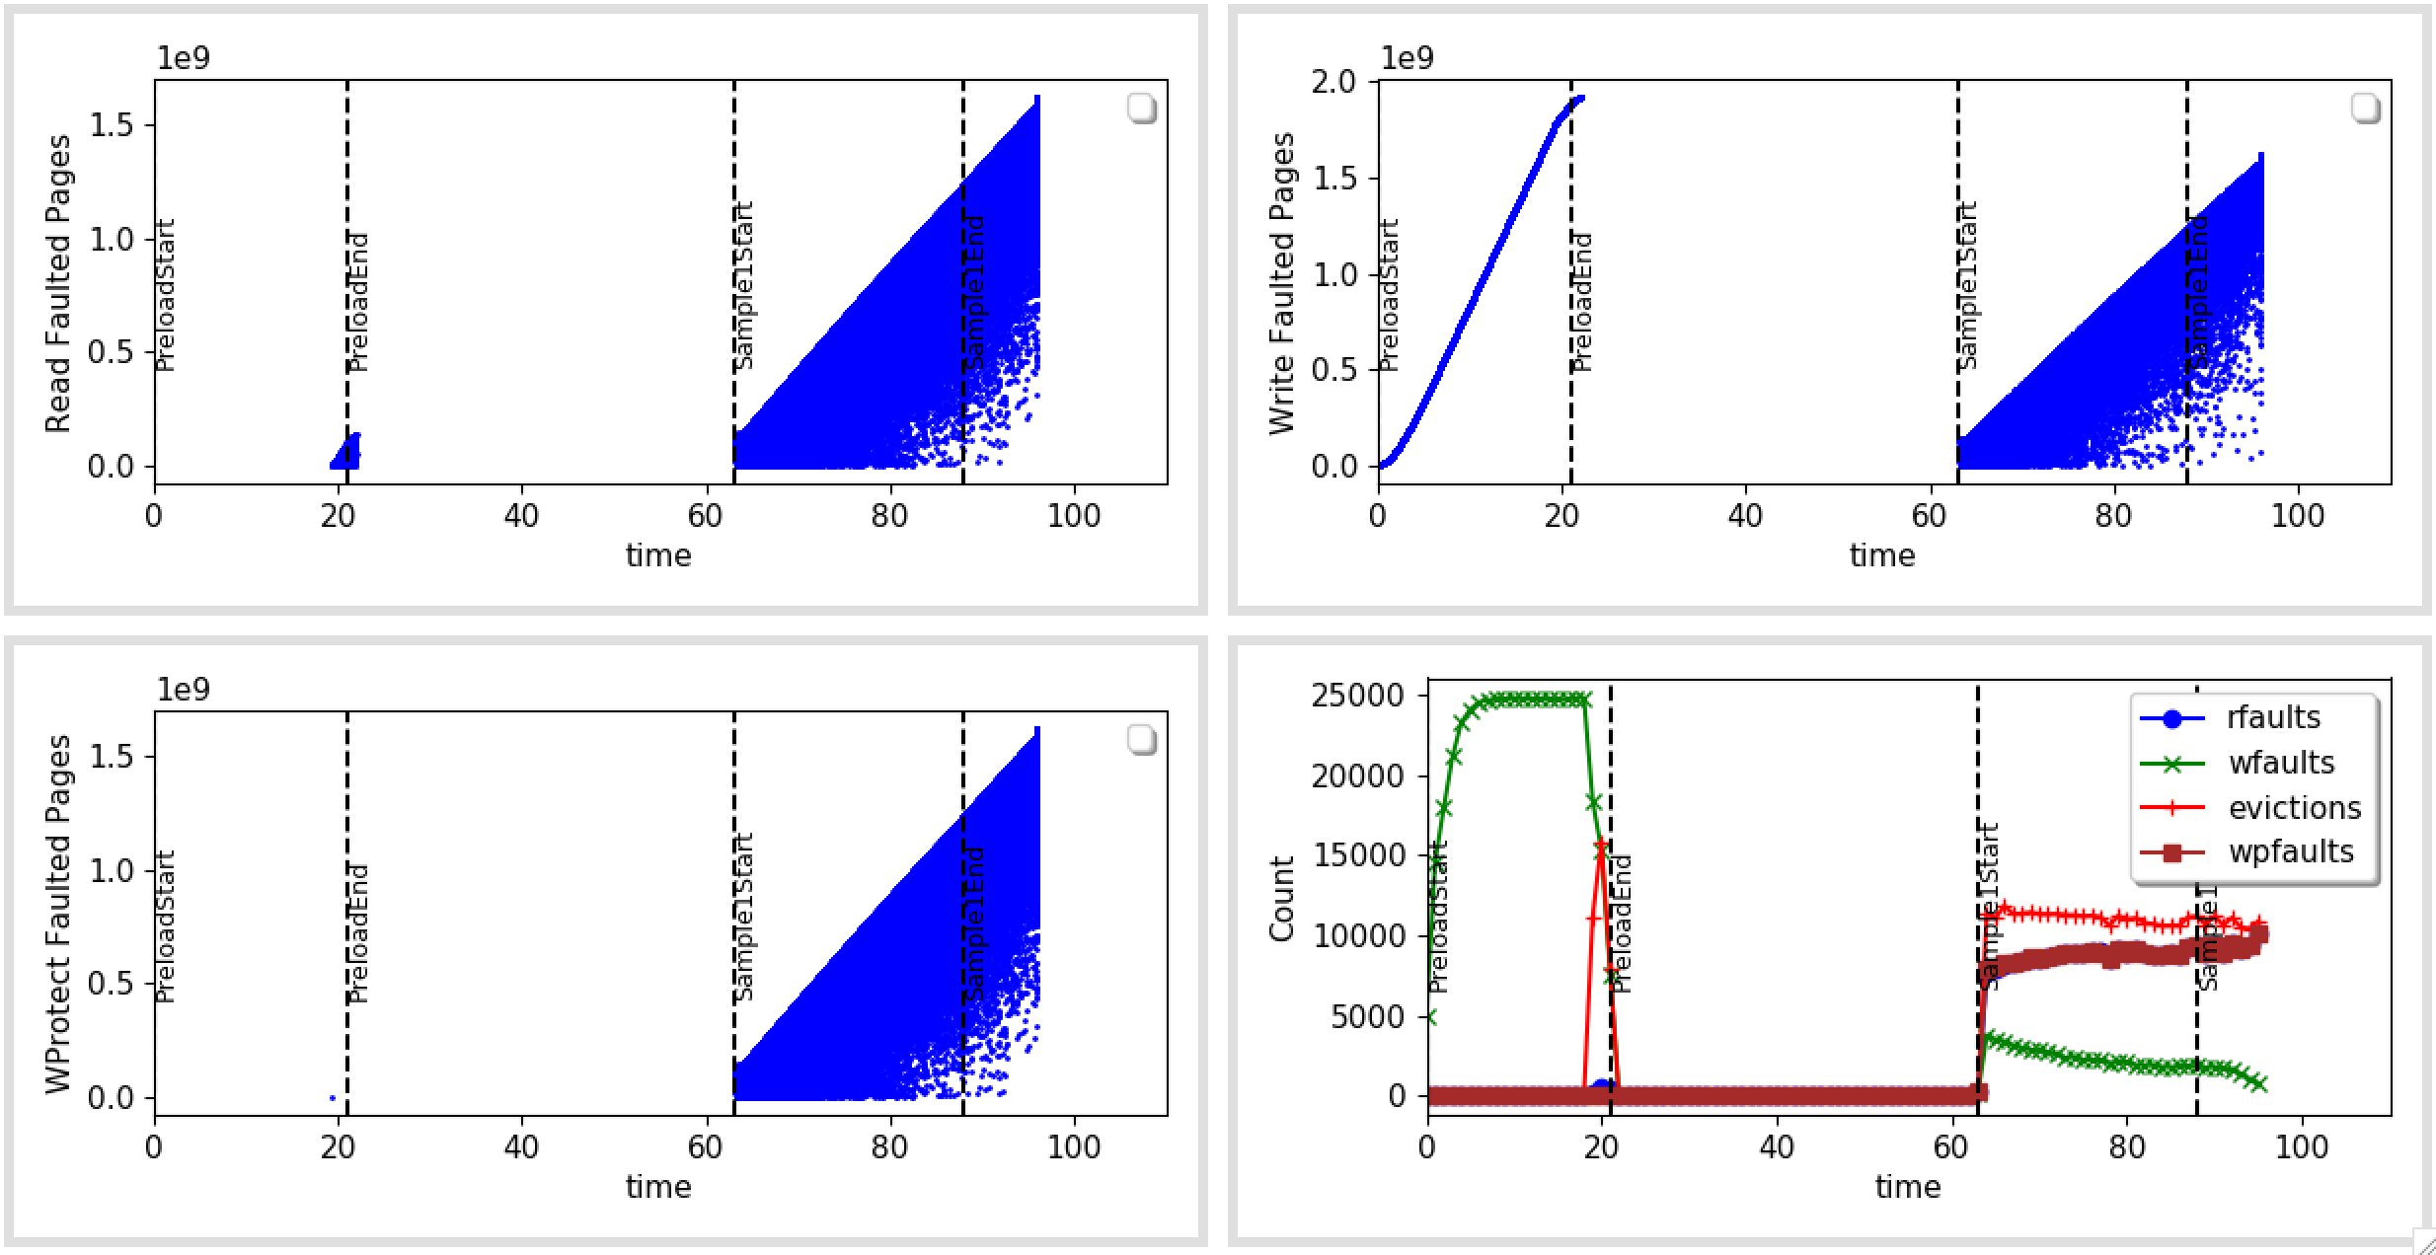
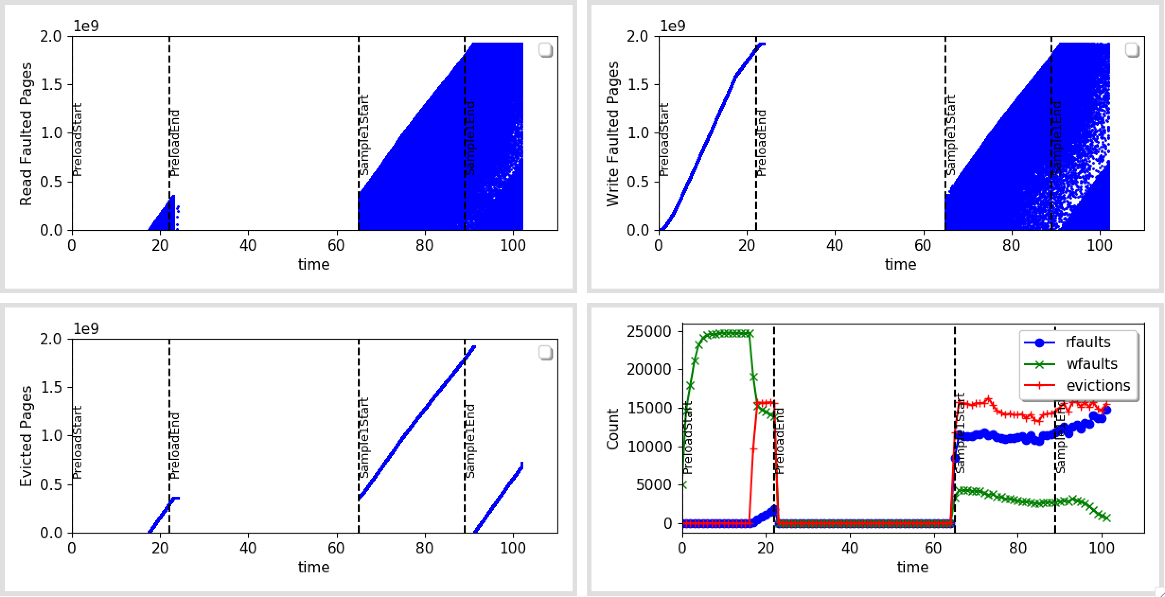
No LRU Maintainer

Slide 9
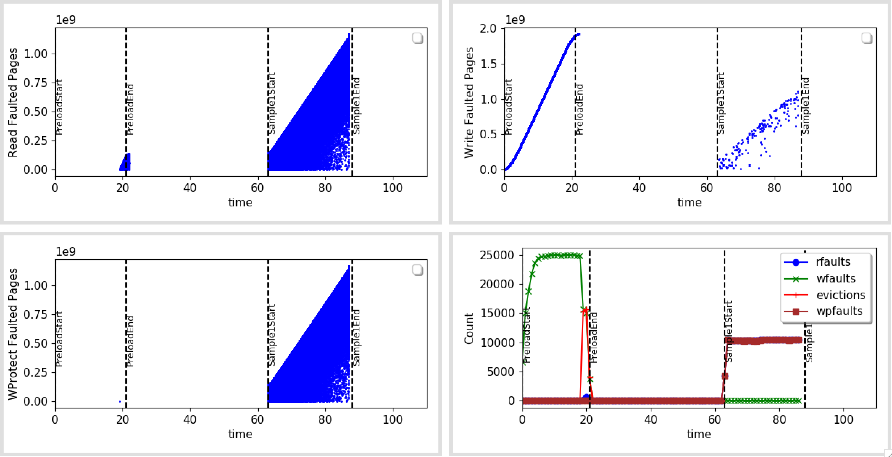
No LRU Maintainer, No LRU update on GET

Slide 10
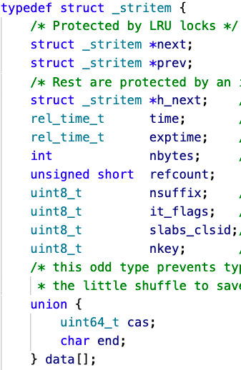
Where do the faults point to in KV Items?
48B + key (20B) + Value (100B)
Takes slab of size 192 B

Slide 11
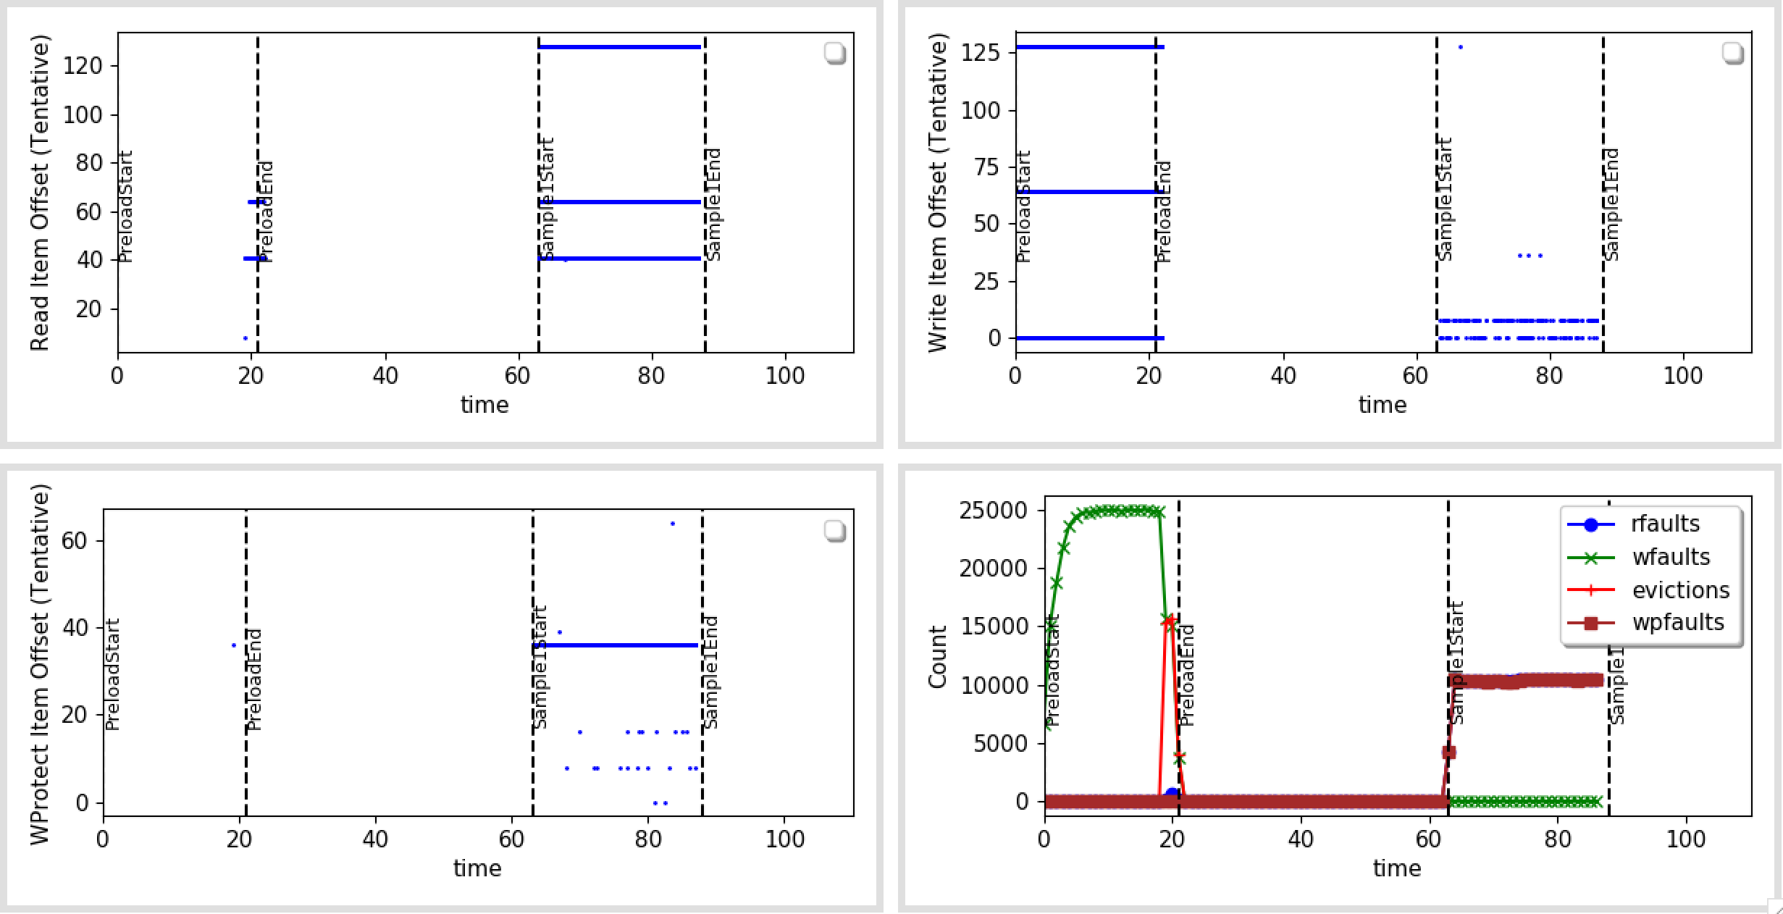
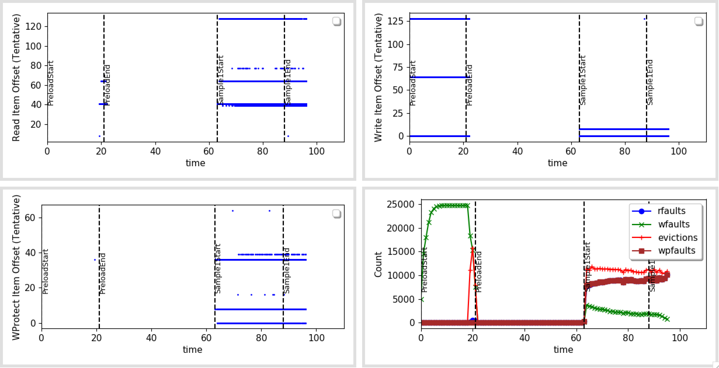
Offset In Item

Slide 12
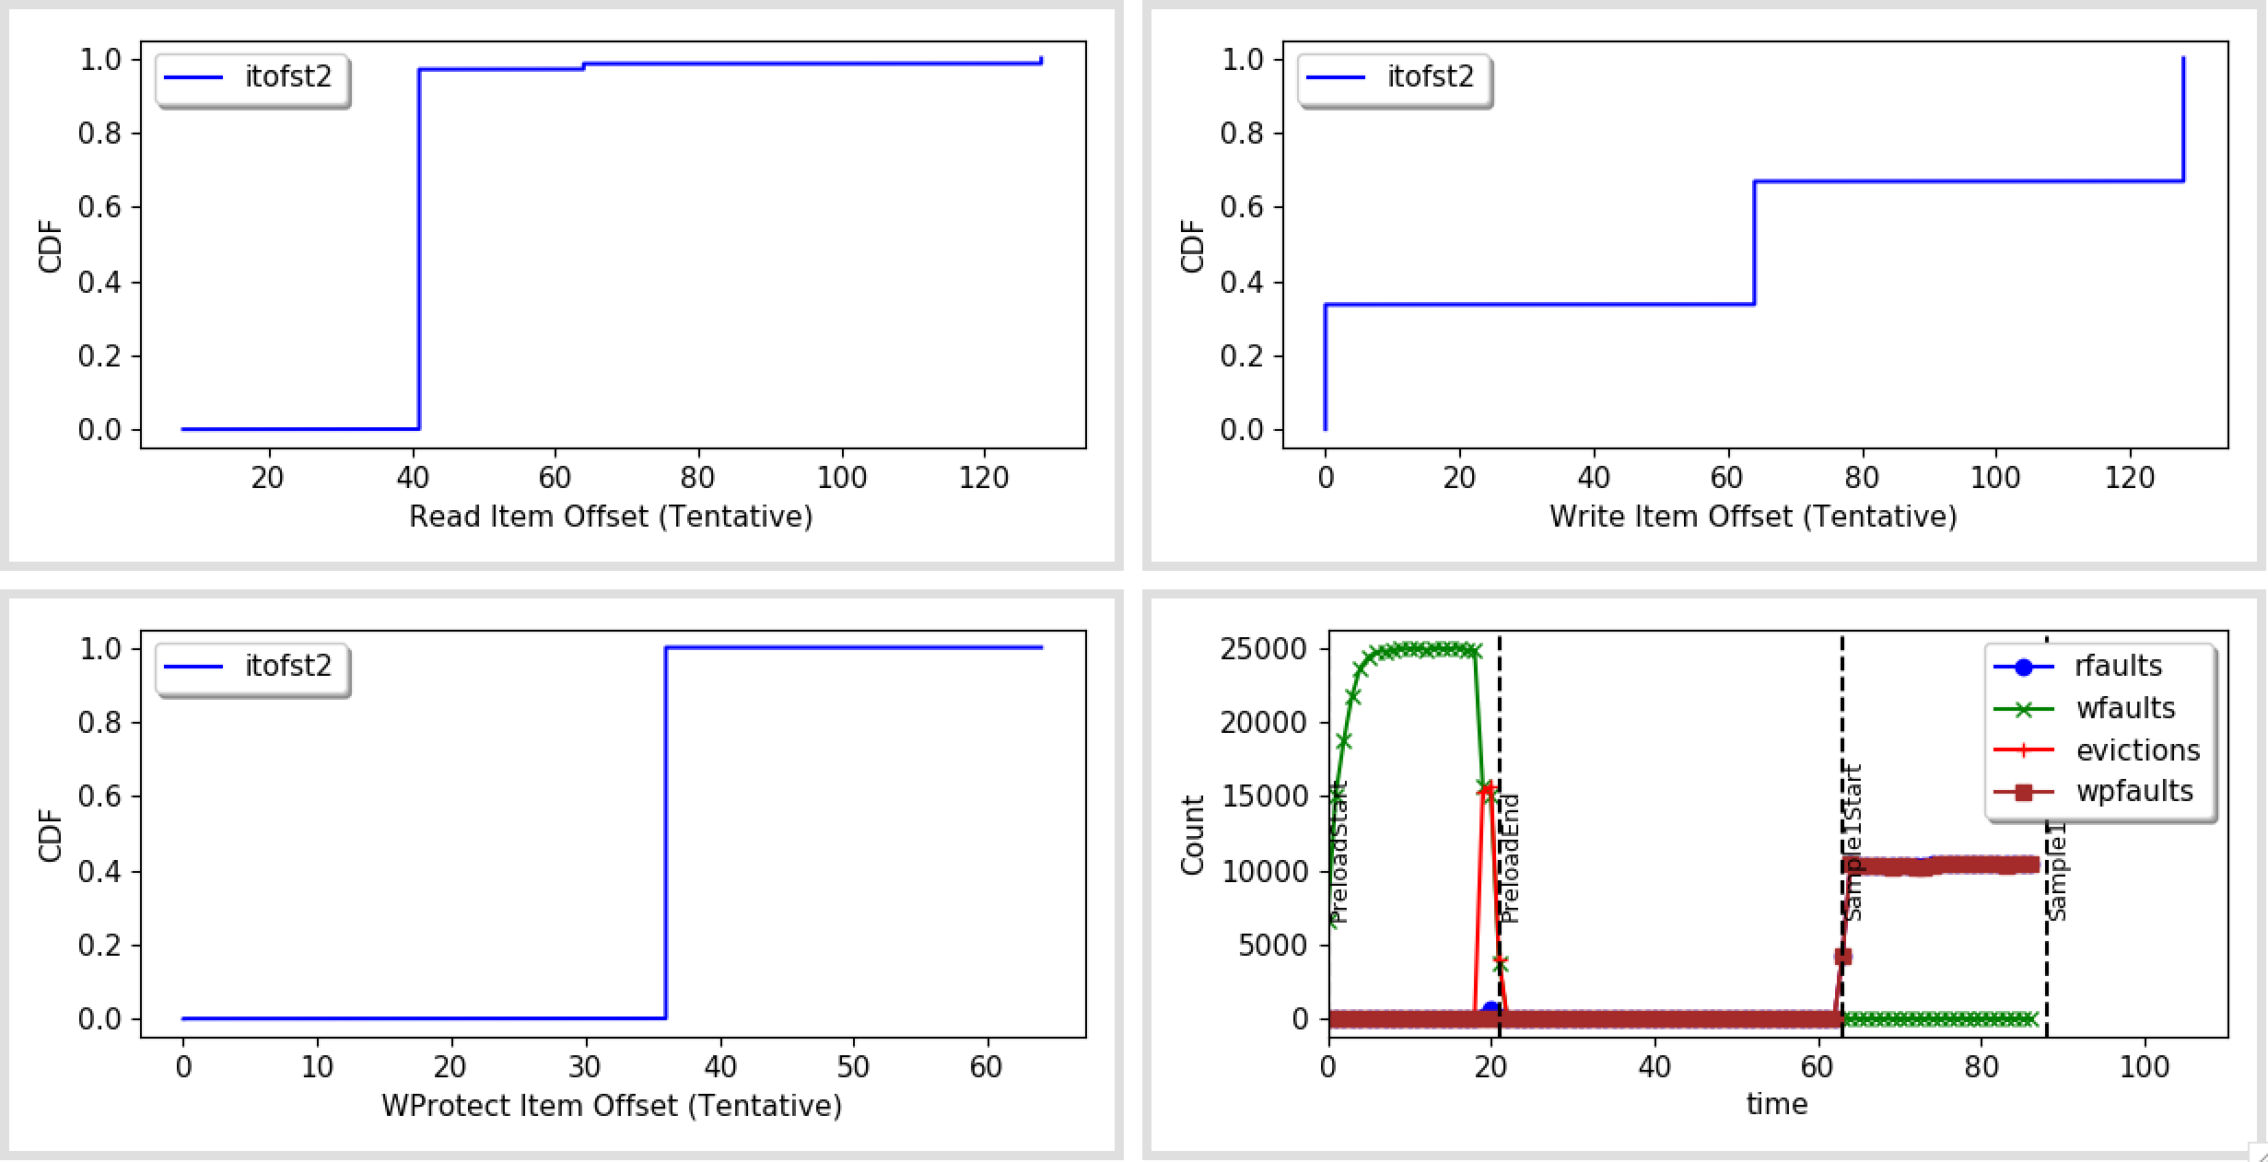
Offset In Item (CDF)

Slide 13
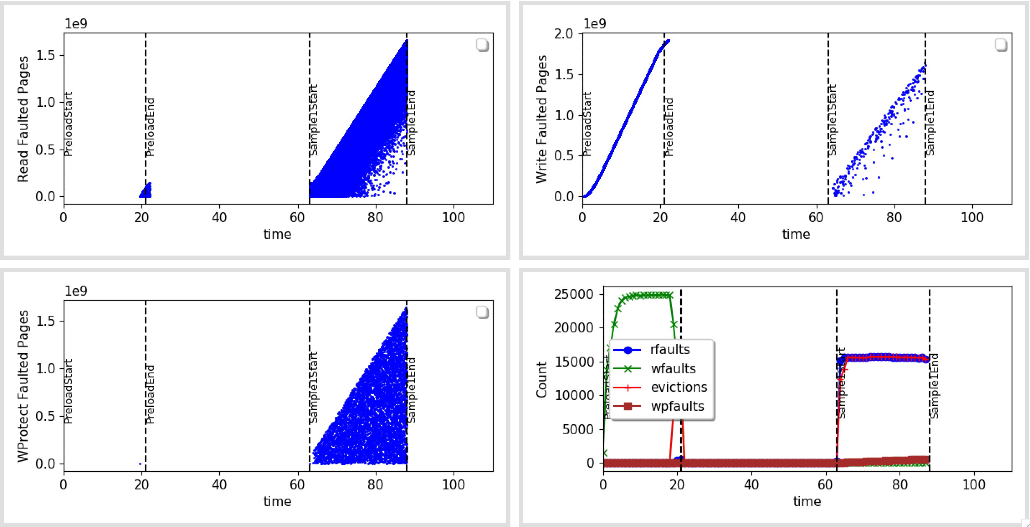
No Refcount on GET

Slide 14
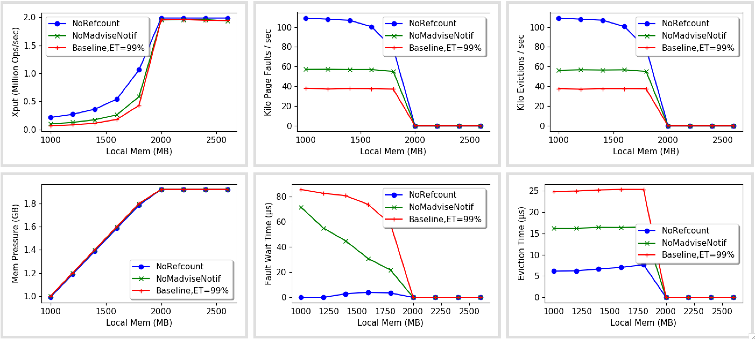
Final numbers

Slide 15
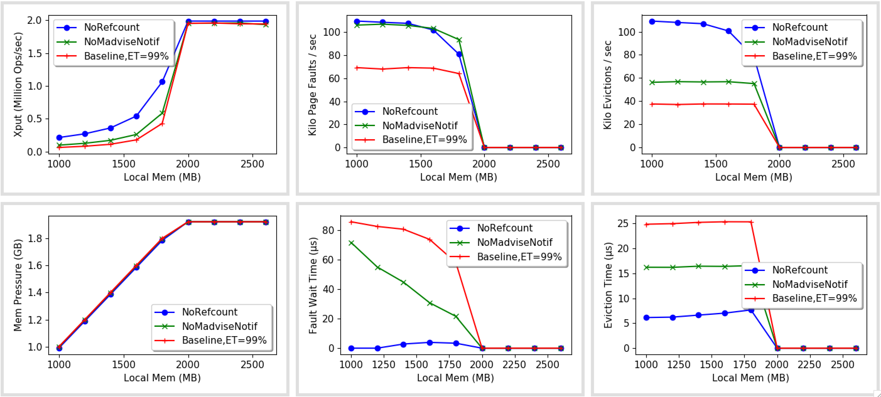
Final numbers (Incl. WP faults)

Slide 16
Next
Increase the number of cores now.
Move to Zipf workload?
How to LRU maintenance/background work efficiently?
Some memory still local:
Hash-table index (2^28)*4 = 1GB
Hash lock table (2^12-15 locks) = 50-200 MB and others
Kailua can explicitly keep these in memory with DNE
Will think about these over the break

Slide 17
Misc

Slide 18
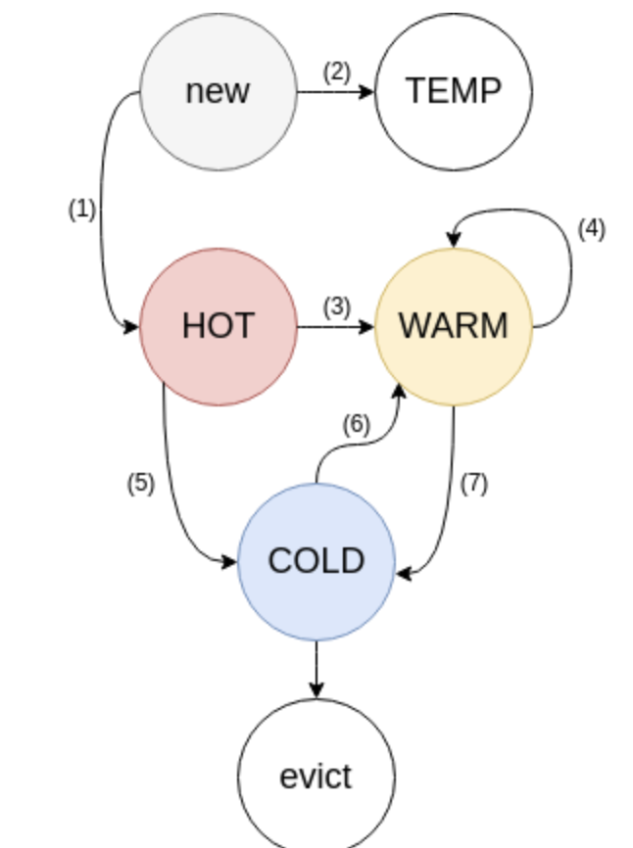
Memcached LRU
Maintainer moves bounced items b/w lists
Crawler removes expired items

Slide 19
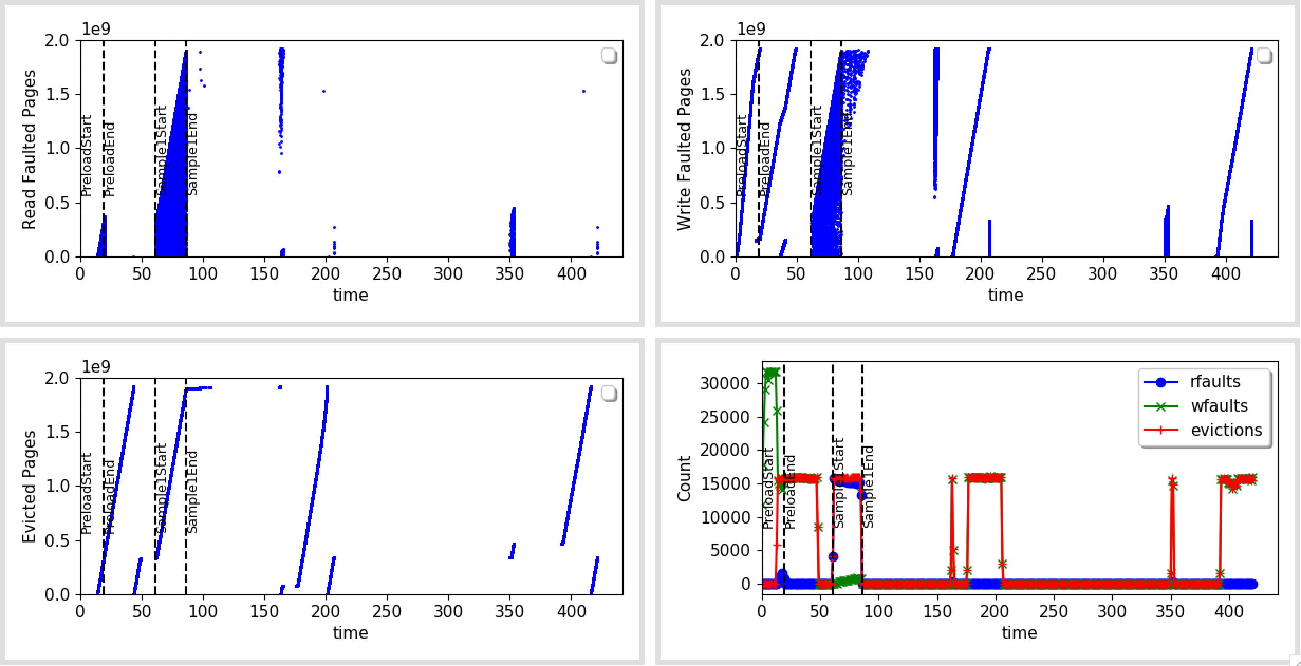
Preload + Run + Background

Slide 20
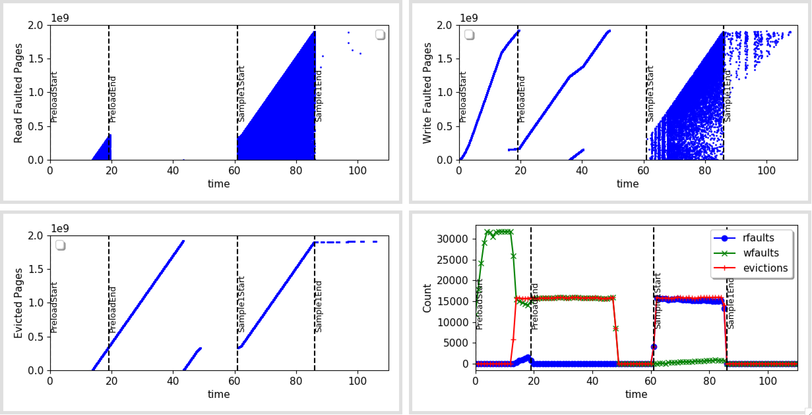
Preload + Run

Slide 21
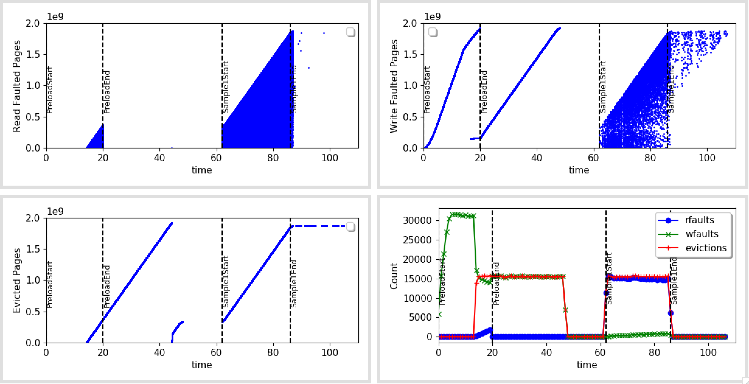
No LRU Crawler

Slide 22
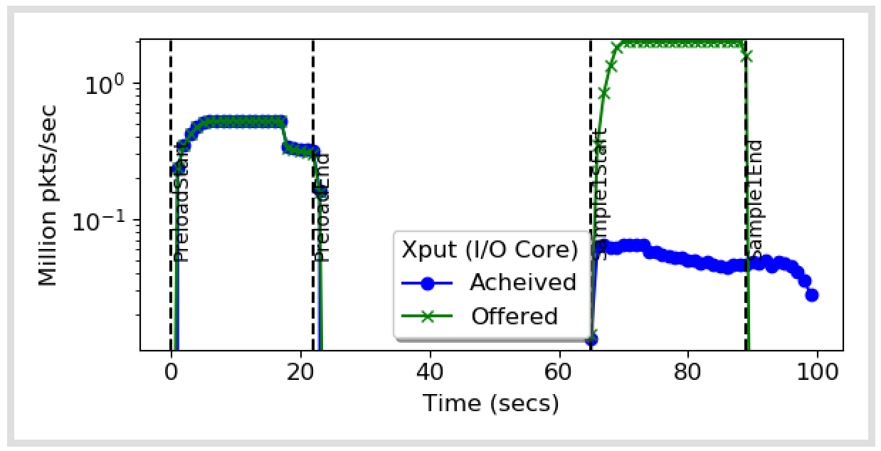
No LRU Maintainer

Slide 23
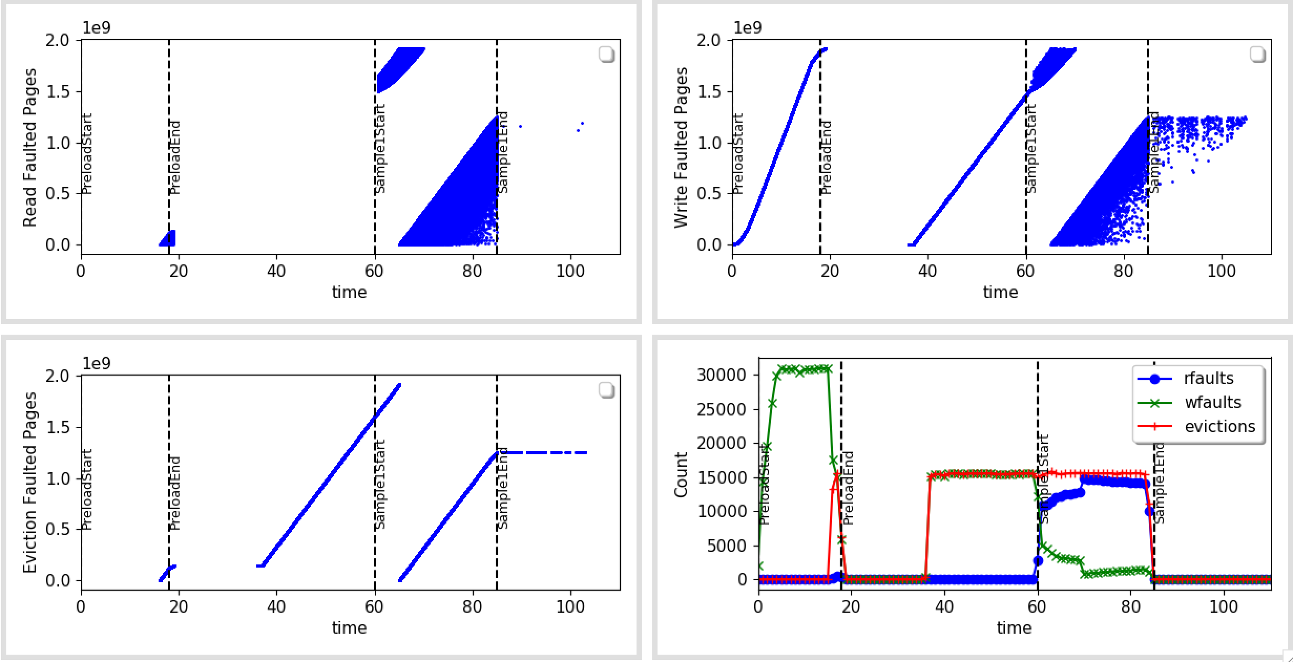
Faults

Slide 24
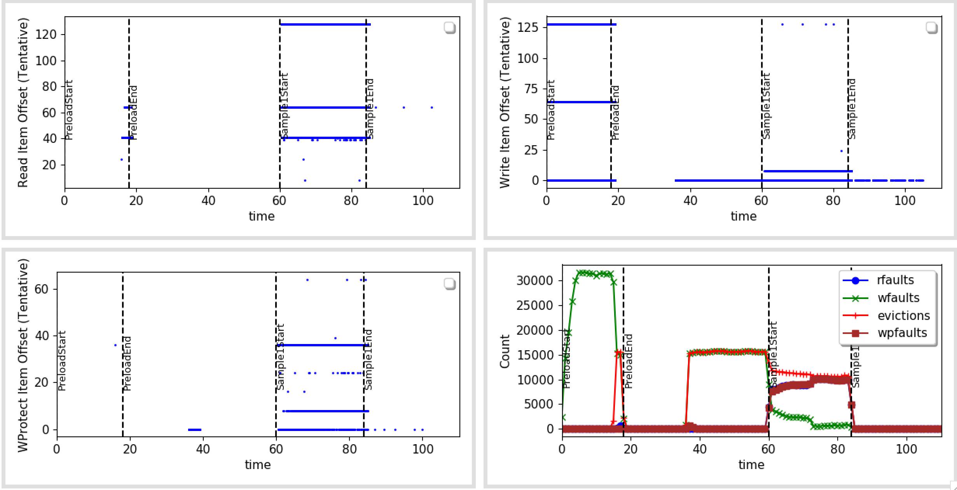
Faults – Offset In Item (With WP)

Slide 25
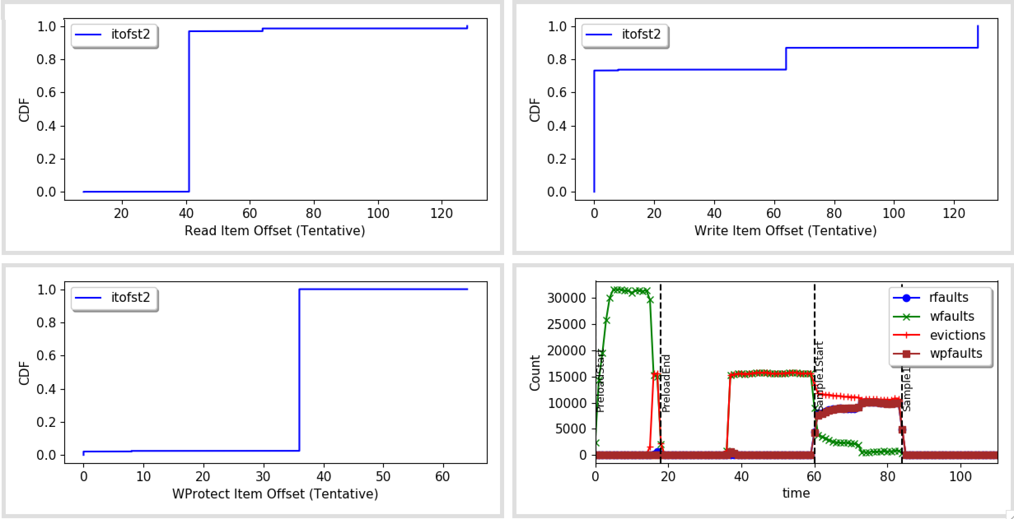
Faults – Offset In Item (With WP) CDF

Slide 26
Faults – Offset In Item (No LRU Maintainer)

Slide 27
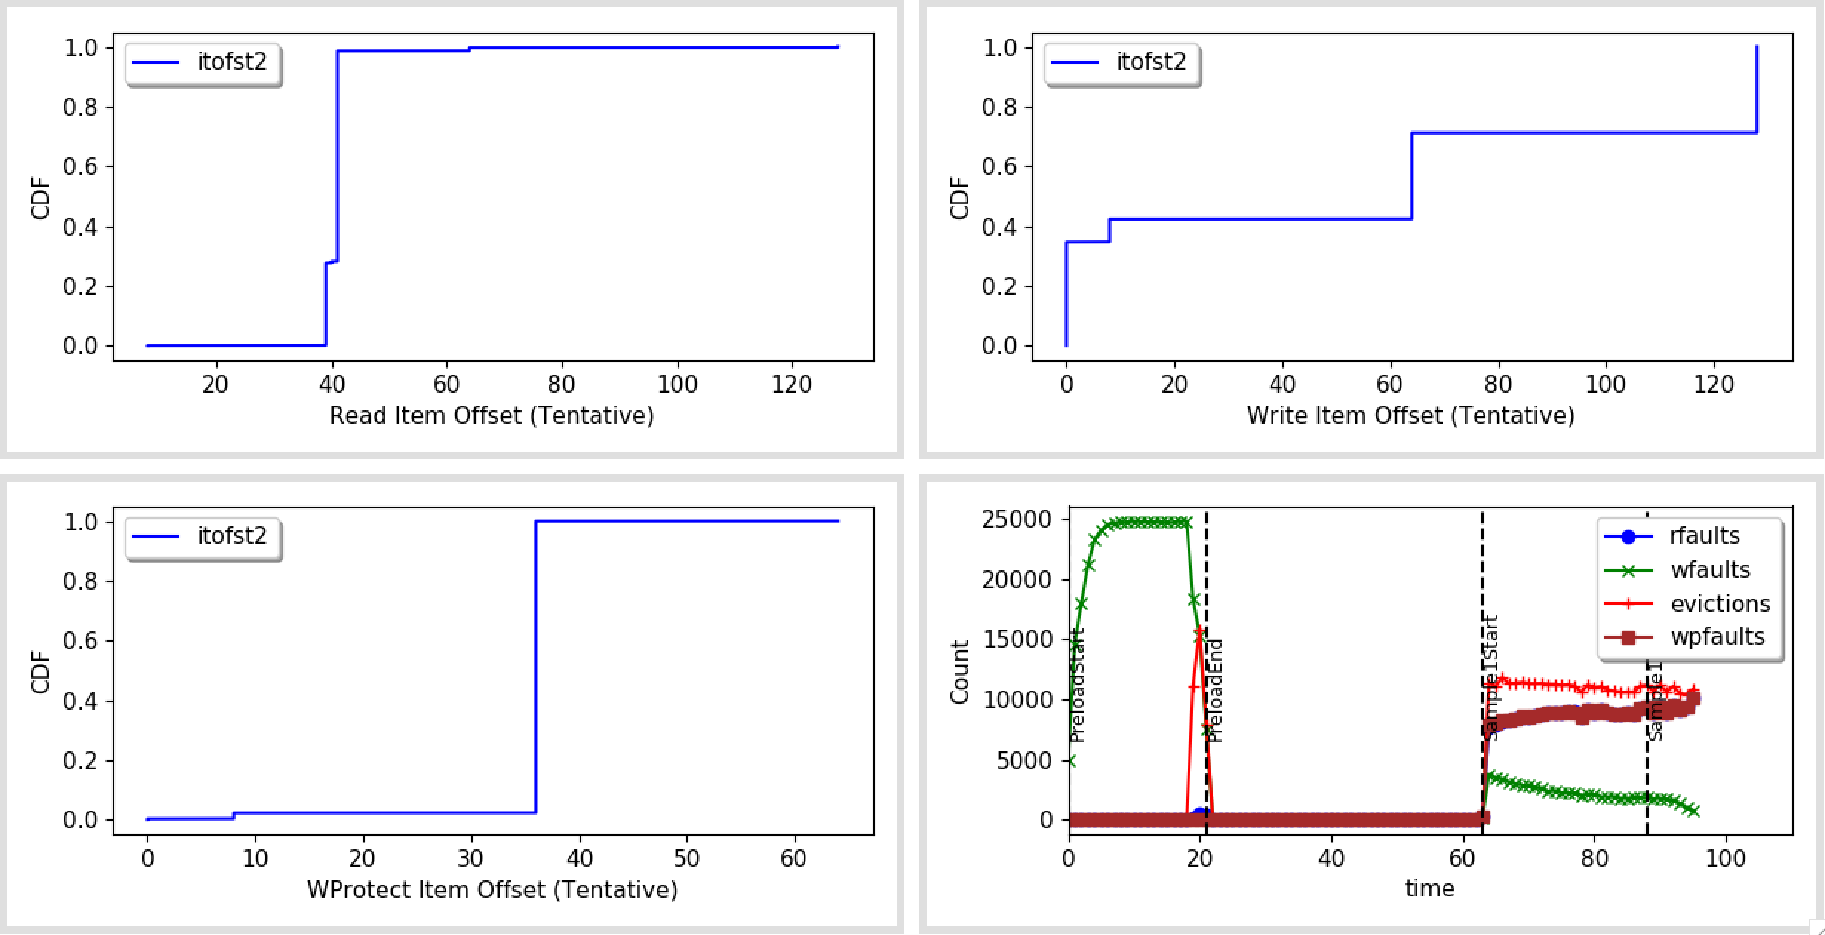
CDF – Offset In Item (No LRU Maintainer)

Slide 28
Faults – Offset In Item (No LRU Maintainer)

Slide 29
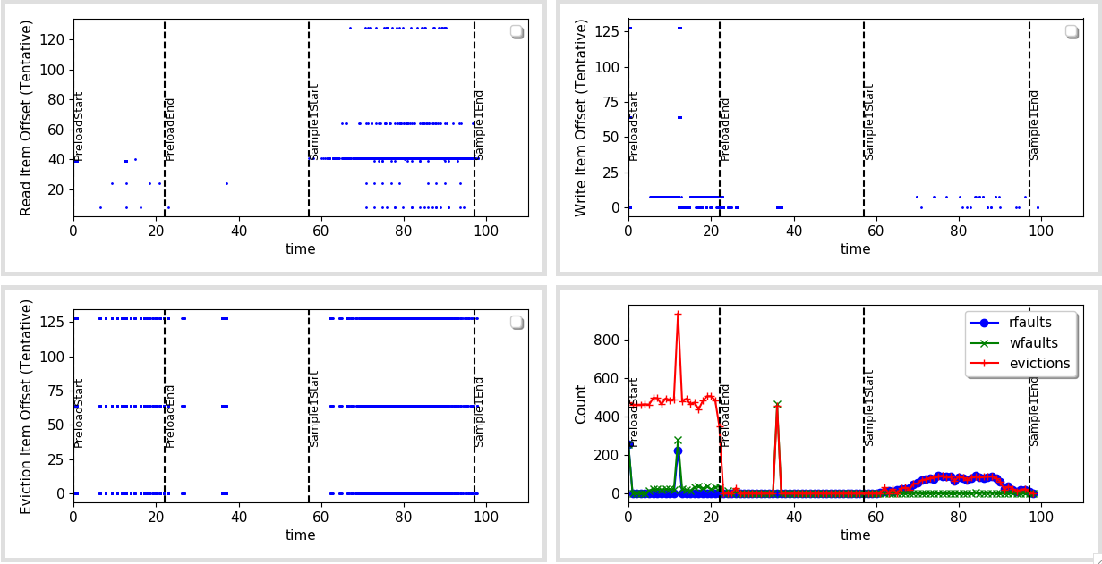
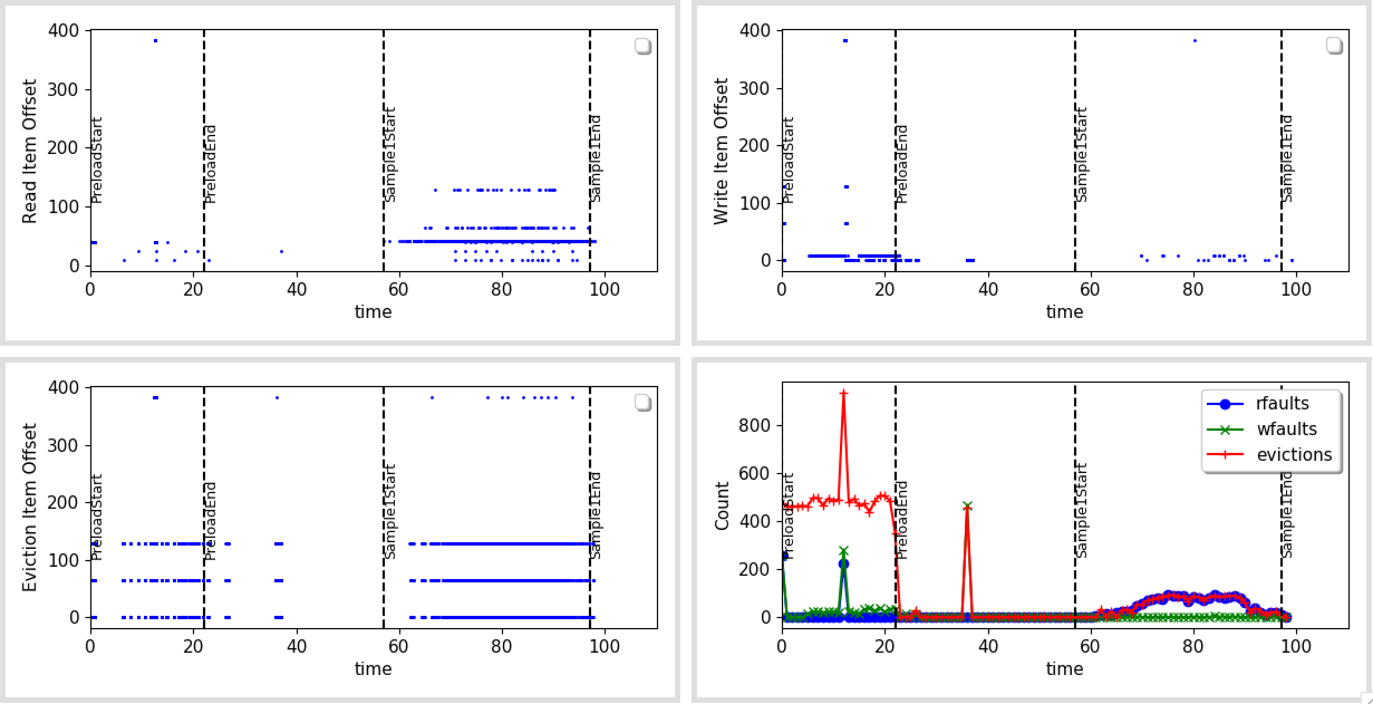
Read/Write Fault Locations
Estimated (Top) vs Actual Item offsets
Except a few outliers, they look pretty much the same.

